Slide 1

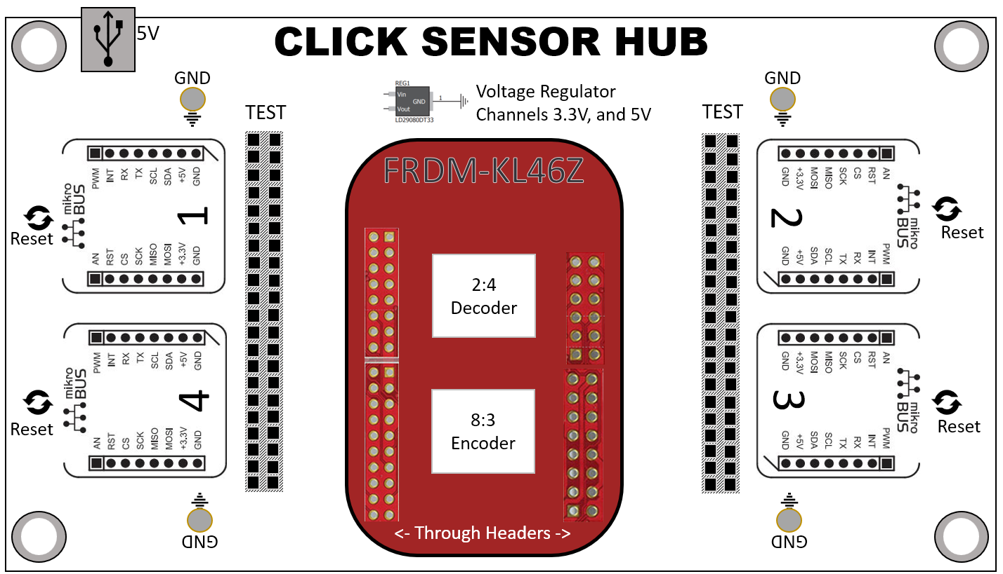

I Project Overview
II Components
III PCB Design
IV Action Plan
V Conclusion
Sponsor: Dr Kevin Kemp
Faculty Advisor: Dr. William Stapleton
Team Members: Alfonso de la Morena [PM], Dylan Dean and Mohamed Sghari
Notes:
Color changed to white, Headers rezised, add chip names (mux ,etc)
Revise Section names

Slide 2

Users
Developers
Scientists
Companies
Students

Slide 3
Project Deliverables
PCB Design
Interface Code
Implementation
Connection between 1 KL46Z and 4 mikroBUS standard sockets
Code for 10 (selected) Click Boards to transmit information via the KL46Z to a text file (formatted)
Use of data analytics to display information from text file demonstrating real world application
Completed December 2018
Completed
March 2019
Completed
April 2019

Slide 4
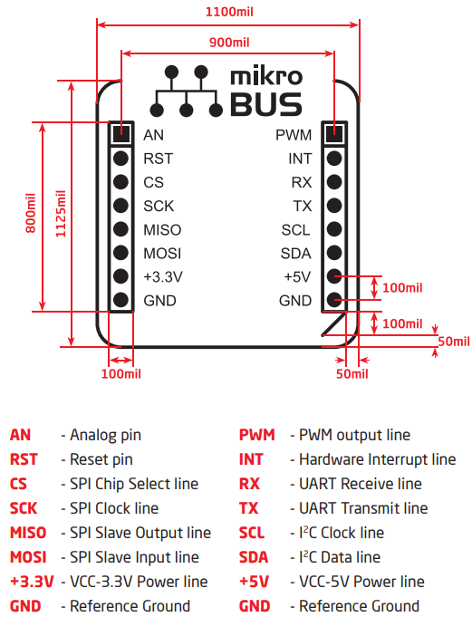
What is mikroBUS?
The mikroBUS host connector consists of:
Two 1x8 female headers containing pins to the most likely target pin on any given click add-on board
There are three groups of communication pins:
SPI, UART and I2C
Single pins for PWM, INT, AN, RST and CS
There are single pins for two power groups:
+5V and GND on left header
+3.3V and GND on right header
mikroBUS host fits all standard breadboards

Slide 5
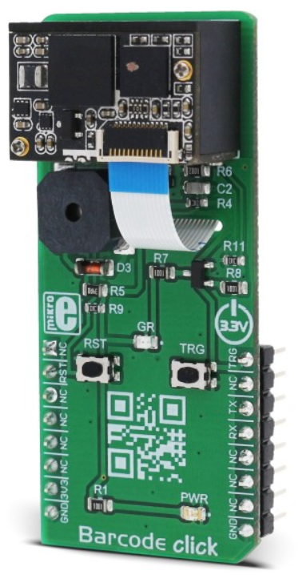
What are click boards?
$180.00 Barcode click
Click Standard | Connection Type
GND | Shared
3.3V and 5V | Shared
SPI: SCK SPI: MOSI SPI: MISO | Shared
IIC SCL IIC SDA | Shared
Analog | Unique
PWM | Unique
SPI: CS | Unique
INT | Unique
RS232 (TX, RX) | Unique per clock
Click add-on boards are the easiest way to add sensors, human interfaces, controls, and wireless communications to your IoT development projects
Designed around the mikroBUS interface standard, click boards add vast customization options to any system with ease

Slide 6
Click Selection Process
CLICK NAME | Brief Description | Interface | Power Channel | Price
USB UART 3 click | Adds USB 2.0 functionality | Serial | 3.3V & 5V | $15.00
Color 5 click | Integrated color sensing device | I2C | 3.3V & 5V | $16.00
BarGraph 2 Click | 10-segment bar graph display, uses a multicolor bar graph LED display | PWM & SPI | 3.3V | $19.00
Gaussmeter click | Gaussmeter used for measuring the magnetic field in X, Y and Z axes | I2C & SPI | 3.3V | $19.00
Alcohol Click | Portable Breathalyzer, sensor estimates BAC | Analog | 3.3V | $15.00
microSD click ​ | A microSD card slot used for mass storage media on devices | SPI ​ | 3.3V​ | $16.00 ​ ​

Slide 7
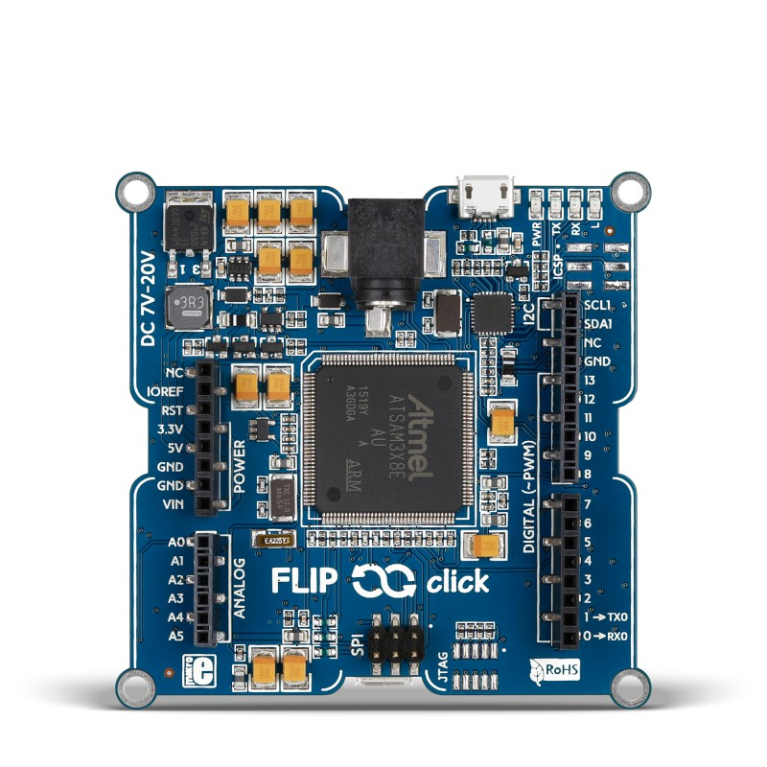
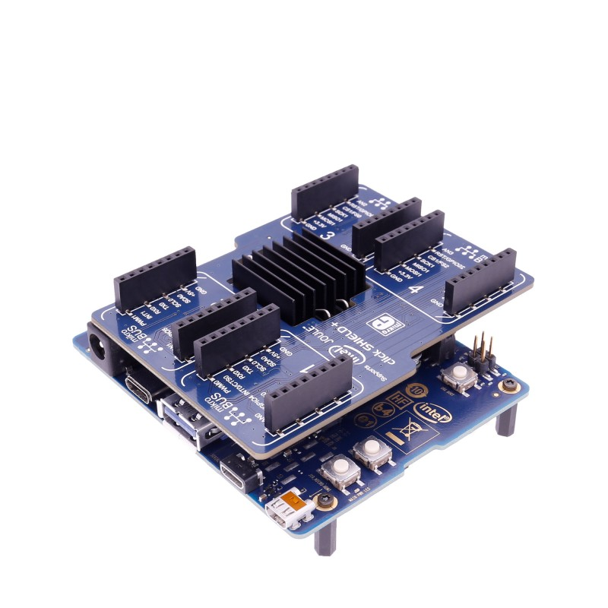
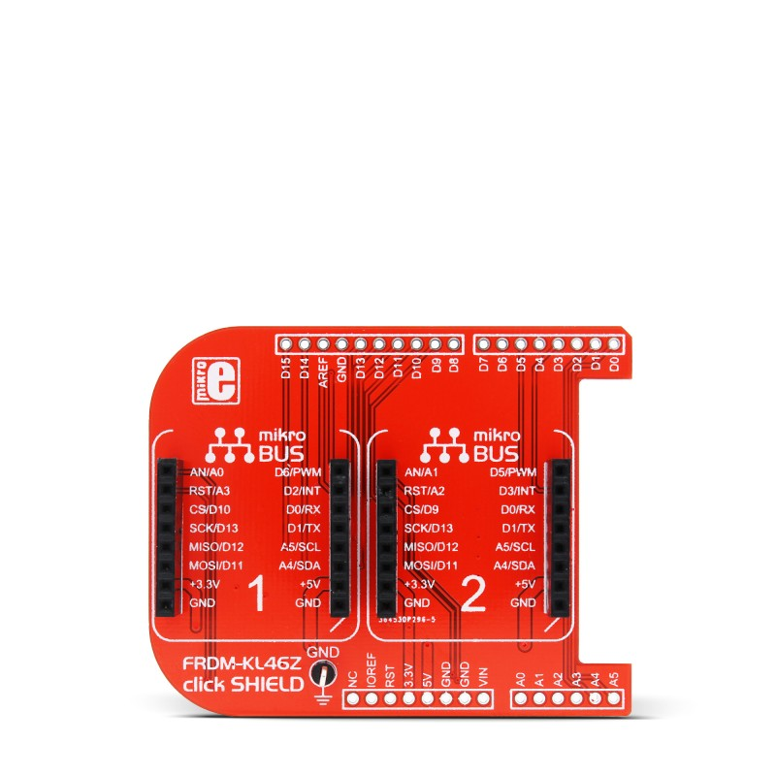
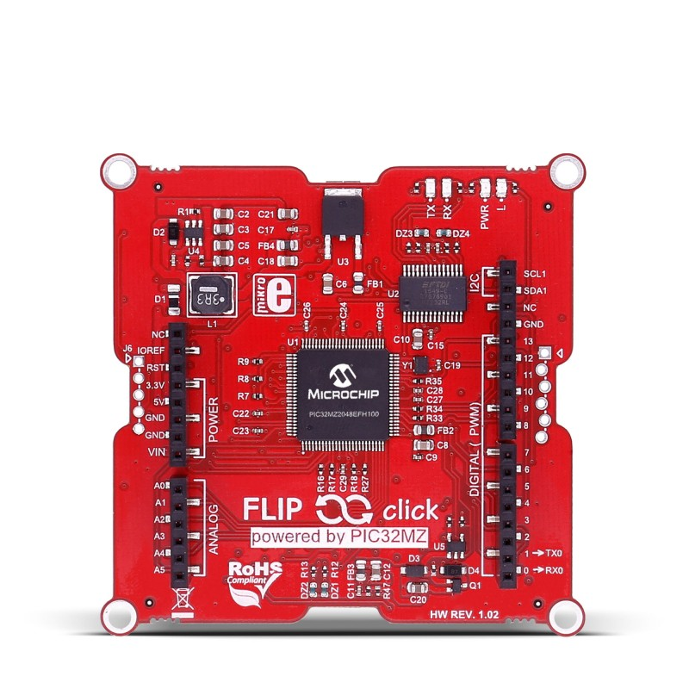
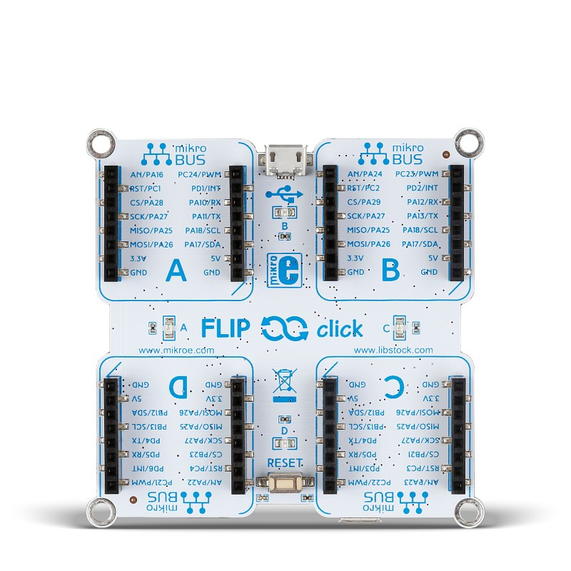
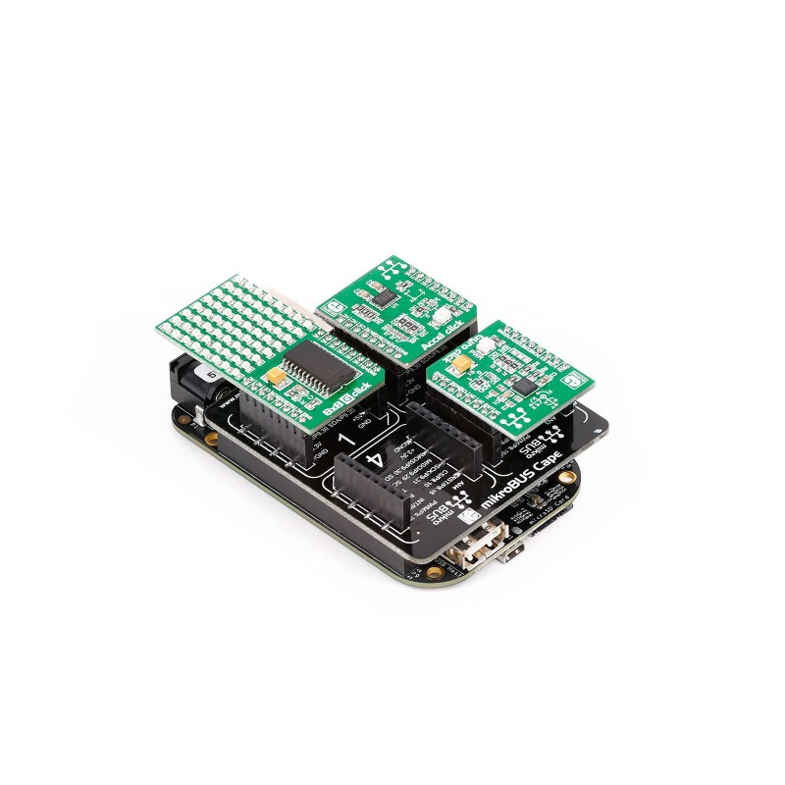
What is The Project and Why?
Arduino Based Boards:
FLIP click
Integrated with MCU
Rough Cost - $50.00
Intel Joule Board:
click SHIELD+
Top Mounted to MCU
Rough Cost - $354.00
Linux Based BeagleBone:
mikroBUS Cape
Top Mounted to MCU
Rough Cost - $71.00
NXP FRDM-KL46Z Board:
click SHIELD
Top Mounted to MCU
Rough Cost - $39.00
Notes:
Unsure of slide placement

Slide 8
Click Sensor Hub Overview
FRDM-KL46Z
click HUB
Bottom Mount: The FRDM-KL46Z connects to a PCB The PCB has four mikroBUS sockets
Layout will meet industry standard to ensure any standardized click will properly interface with the board

Slide 9
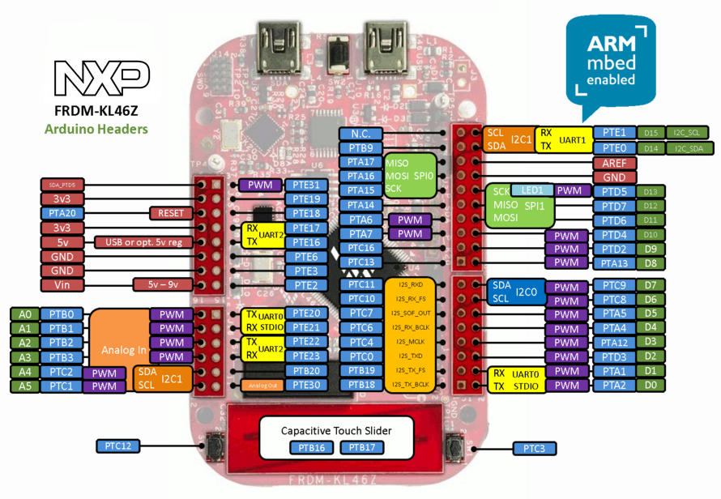
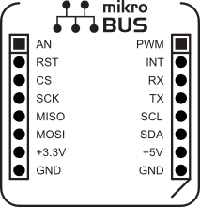
Interface Challenges
mikroBUS | FRDM-KL46Z | Pin Names | State
4 SPI | 2 SPI | SCK MOSI MISO SS / CS | Shared Shared Shared Unique
4 I2C | 2 I2C | SCL SDA | Shared Unique
4 Analog | 6 Analog | AN | Unique
4 PWM | 6 PWM | PWM | Unique
4 Interrupts | 6 Interrupts | IN | Unique

Slide 10
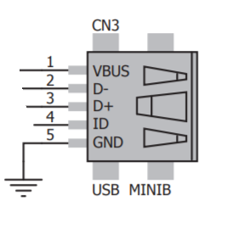
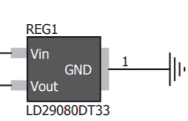
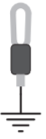
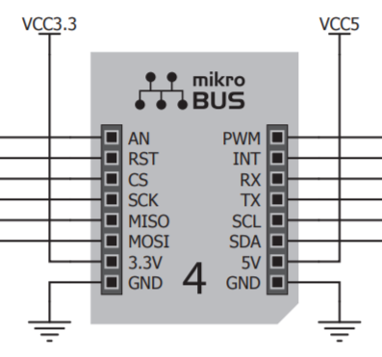
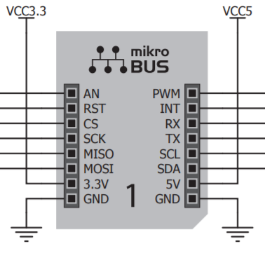
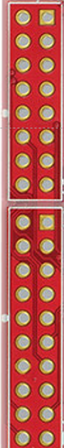
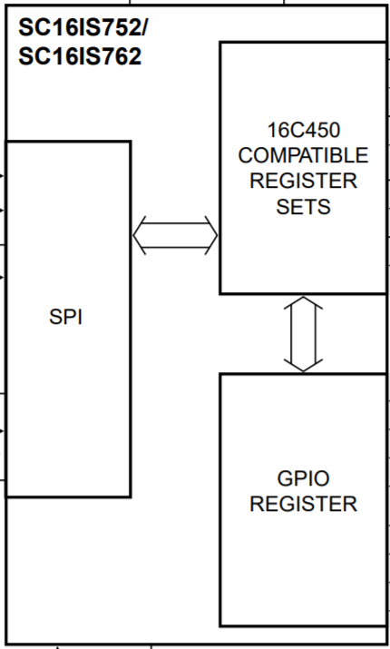
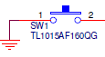
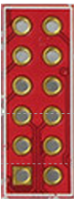
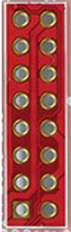
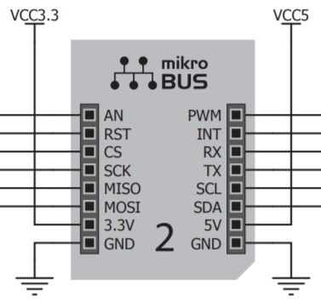
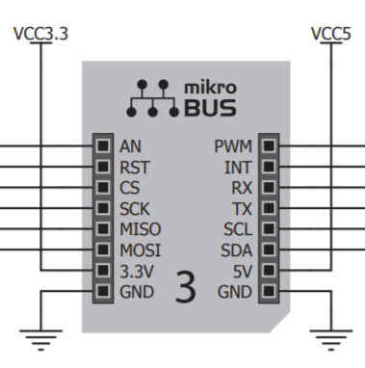
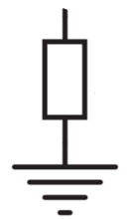
Power
Input
Voltage Regulator
2 channels 3.3V&5V
SPI
SPI TO UART
I2C
PWM
ANALOG
INTERRUPTER
RESET
Test Point
Reset Button
Convert
SPI to UART
J1
RX_1
RX_4
J4
TX_1
TX_4
PWM_1
SS_0
RX_2
RX_3
PWM_2
SS_1
TX_2
TX_3
AN_1
PWM_3
SS_2
AN_2
PWM_4
SS_4
AN_3
AN_4
ENCO_3
MOSI_1
ENCO_2
MISO_1
ENCO_1
CS_4
GND
SCK_1
SCK_0
2:4
CS_3
v5v
MOSI_0
CS_2
v3v
MISO_0
CS_1
SDA
SCL
J2
Decoder 2 to 4
Select Slaves
J3
R1
SPI_SC_1
PTA14
R2
SPI_SC_2
Reset Button
INT_1
8:3
PTA6
INT_2
PTA7
INT_3
Test Point
INT_4
Priority Encoder 8 to 3
Interrupter

Slide 11
Roles & Responsibilities
Alfonso de la Morena
Project
Manager
Dylan Dean
Software Engineering
Mohamed Sghari
Hardware Engineering
Activity and resource planning
Managing Reports
Full Implementation Functionality Test
Stretch Goal – Website Design
Stretch Goal – Full Website Functionality Test
PCB design
Code Architecture
Full Click Functionality Test
Senior Design Presentation Design
Stretch Goal – Website Design
PCB design
Full PCB Functionality Test
Full Click Functionality Test
Senior Design Poster Design

Slide 12
Testing
Hardware
Software
Software (Stretch)
Test Points on PCB
Transfer readings all 10 Clicks to text file
Website must update data periodically from source file
10 Clicks must be functional
4 Sockets on PCB tested with all 5 interfaces
Invalid reading from any Click recognized and properly handled
Must be accessible for IE, Firefox, Chrome and Safari

Slide 13
Project-Specific Milestones
Projected Team Milestones | Completion Date | Person Responsible
Design for PCB Completed | 11/01/18 | Mohamed
Draft Poster for Review | 11/12/18 | Mohamed
PCB Ordered and Tested | 12/30/18 | Mohamed
Second Cycle Design for PCB in Case of Errors Completed | 1/15/19 | Mohamed
Code to Translate Click Readings to Output File Completed | 1/15/19 | Dylan
Output File for all 10 Clicks tested with Data Analytics Platform | 1/15/19 | Alfonso
Stretch Goal – Website HTML and CSS Code Written and Tested | 2/16/19 | Alfonso
PCB Components Test Completed | 2/16/19 | Mohamed
Click Functionality Test Completed | 2/16/19 | Dylan
Code to Translate Click Readings to Output File Tested and Approved | 3/3/19 | Dylan
Functionality Test Between PCB and Click Code | 3/3/19 | Dylan
Implementation of Data with Analytics Platform Functionality Test | 3/16/19 | Alfonso
Stretch Goal - Website JavaScript and Tableau Data Analytics Implemented | 3/16/19 | Alfonso
Stretch Goal - Website Functionality Test | 4/16/19 | Alfonso
Project Functionality Test | 5/9/19 | Alfonso
Final Poster Submitted and Printed | 5/9/19 | Mohamed
Final Presentation Prepared and Approved | 5/9/19 | Dylan
Notes:
FIXED What are your Opnions?

Slide 14
Conclusion
PCB Design
Interface Code
Implementation
Connection between 1 KL46Z and 4 MikroBUS standard sockets
Code for 10 (selected) Click Boards to transmit information via the KL46Z to a text file (formatted)
Use of data analytics to display information from text file demonstrating real world application
Completed December 2018
Completed
March 2019
Completed
April 2019

Slide 15
End of Presentation
From this point on following slides are all tentative or to be used in case a relevant question is asked.

Slide 16
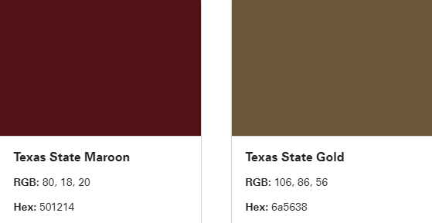

PROPER COLORS

Slide 17
Hardware Performance
Parameter | Test Conditions | Min | Max | Units | Tested
Click Sockets work for any Click | PCB is on | 2 | 3 | Clicks | Each socket in PCB will be tested with at least 2 Clicks. The connection must be recognized by the FRDM-KL46Z which must receive a sensor reading.
Click sensor functionality | Each Click is powered on and placed on a breadboard | 10 | 10 | Click | Each Click will be tested for output on a breadboard before being connected to the main board. It must send a signal according to the type of interface it uses.
FRDM-KL46Z Functionality | FRDM-KL46Z is on and placed on a breadboard. | 20 | 30 | Pins | The pins on the FRDM-KL46Z will be tested with an Mbed program that will turn on a flag each time a pin receives a signal.
Notes:
Remove this nephew

Slide 18
Software Performance
Function | Description | Tested
New releases | When a new/updated version or release of the software is released, the website will post an update should be notified | Include latest version tab in website and update it with a fake version
Click Sensor Reading time | Data read from sensor within 30 second range of manufacturer specification | Use a timer to measure time it takes to display reading on console
Memory usage | The amount of Operating System memory occupied by the application. Target is 100KB, limit is 200KB | Observations done from the performance log during testing
System reliability | The reliability that the system gives the right result | Test stored values over a period of 3 minutes for each Click with no deviation from upper and lower boundaries specified.
Code error handling | The code written will be able to handle incorrect readings from sensors | Out of range values will be input for each in the code for each Click. The system will detect the error and
Notes:
IM GONNA FIX THIS – The Dingo

Slide 19
Software Performance (Stretch)
Function | Description | Tested
New releases | When a new/updated version or release of the software is released, the website will post an update should be notified | Include latest version tab in website and update it with a fake version
Website loading times | Loads in 30 seconds or less | Use a timer to measure load time
Memory usage | The amount of Operating System memory occupied by the application. Target is 1GB, limit is 10GB | Observations done from the performance log during testing
System reliability | The reliability that the system gives the right result | Feed 20 different data streams to website during testing
Website easy to use | Intuitive interface and clear data display | Each member of the team will show website to 2 other users and record their opinions and suggestions on the design
Platforms | The system will run on the following computer platforms: (a) Windows 10 (b) Windows 7 | Test all functions listed above on all platforms
Notes:
IM GONNA FIX THIS – The Dingo

Slide 20
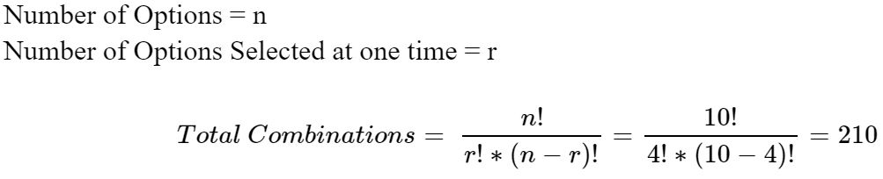
Sensor Hub Customization
Creative Capacity: With 10 Clicks and 4 sockets is a total of 210 combinations

Slide 21
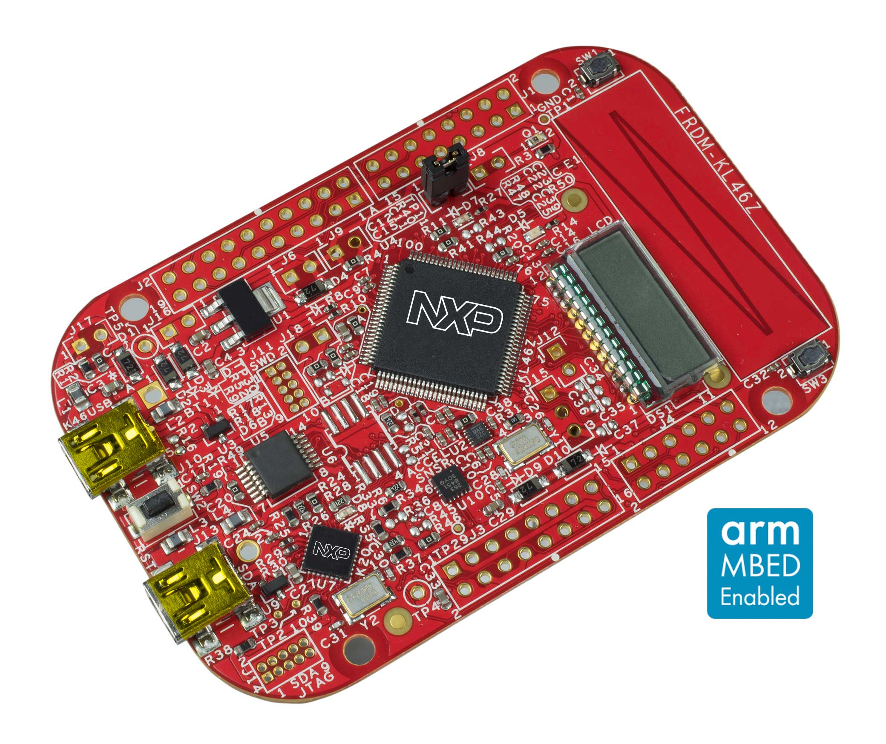
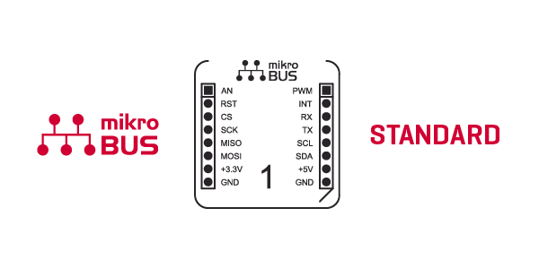
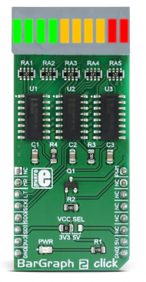
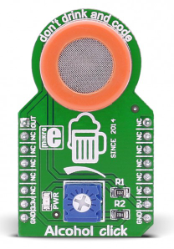
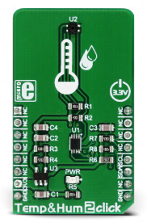
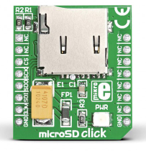
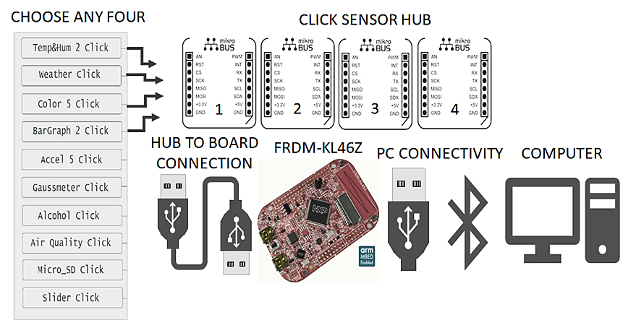
Detailed Connectivity
$19.00
$15.00
BarGraph 2 click
Alcohol click
PWM
Serial
The MikroBUS standard enables easy hardware expandability with a large number of standardized compact add-on boards via multiple interface types.
Analog
The Freedom KL46Z is a development board made by NXP built on the built on the Arm Cortex -M0+ processor
IIC
SPI
Temp&Hum 2 Click
MicroSD click
$16.00
$16.00

Slide 22
Error Handling
Click Input / Output Validation
Powered Devices Communication Channel
Verified
KL46Z stores Click Sensor reading
Serial
Serial
Click has power
KL46Z has power
Click
PWM
Click Sensor sends reading
PWM
KL46Z verifies input (as defined in Mbed code)
Store
Text file in host computer
(File size < 1GB)
IIC
IIC
SPI
SPI
Invalid
KL46Z stores invalid reading string
Signal received
Access
Missing
Data Base has power
Data base
Signal sent
Analytics or Web Display
Signal stored
KL46Z

Slide 23



Service, Support and Maintenance
Maintain a clean board
Use latest software versions
Disconnect from power supply when not in use

Slide 24
Project Selected Clicks
CLICK NAME | Description and Interface | Interface | Power Supply | Price
Temp&Hum 2 Click | Measures a wide range of temperature and relative humidity values with a great accuracy | I2C | 3.3V | $16.00
USB UART 3 click | Adds USB 2.0 functionality | Serial | 3.3V & 5V | $15.00
Color 5 click | Integrated color sensing device | I2C | 3.3V & 5V | $16.00
BarGraph 2 Click | 10-segment bar graph display click, which uses a high-quality, multicolor bar graph LED display | PWM & SPI | 3.3V | $19.00
Accel 5 click | Triaxial accelerometer sensor | I2C & SPI | 3.3V | $19.00
Gaussmeter click | Gaussmeter used for measuring the magnetic field in X, Y and Z axes | I2C & SPI | 3.3V | $19.00
LightRanger 3 Click | Accurate distance measurement based on a ToF (Time of Flight) measurement principle | I2C | 3.3V | $24.00
Alcohol Click | Portable alcohol detector, breathalyzer for estimating BAC | Analog | 3.3V | $15.00
Air Quality Click | detecting a variety of gases that impact air quality in homes and offices | Analog | 3.3V | $16.50
microSD click | A microSD card slot for microSD cards used as a mass storage media for portable devices | SPI | 3.3V | $16.00

Slide 25
SPI: Serial Peripheral Interface
Separate clock and data lines, along with a select line to choose the device you wish to talk to
Master
Slave
CSCK
CSCK
MOSI
MOSI
FRDM KL46Z
MISO
MISO
Click
SS
SS
GND

Slide 26
The SPI devices disconnect their MISO pins when they are not selected
Each slave will need a separate SS line
SLAVE 1
SLAVE 2
SLAVE n
SCK
MOSI
MISO
SS
SCK
MOSI
MISO
SS
SCK
MOSI
MISO
SS
Master
SCK
MOSI
MISO
SS _ 1
SS _ 2
SS _ n

Slide 27
I2C
minimize number of pin and send more that 8 bits data
You can have up to 127 devices on a same bus
R1 and R2 are depended on slave and master voltage
Master
Slaves (n)
R1
Clock (SCL)
Data (SDA)
FRDM KL46Z
R2
Click

Slide 28
Slave 1
Slave 1
Slave n
CLICK 1
CLICK 1
CLICK n
SCL SDA
SCL SDA
SCL SDA
Master
R1
Clock (SCL)
Data (SDA)
R2

Slide 29
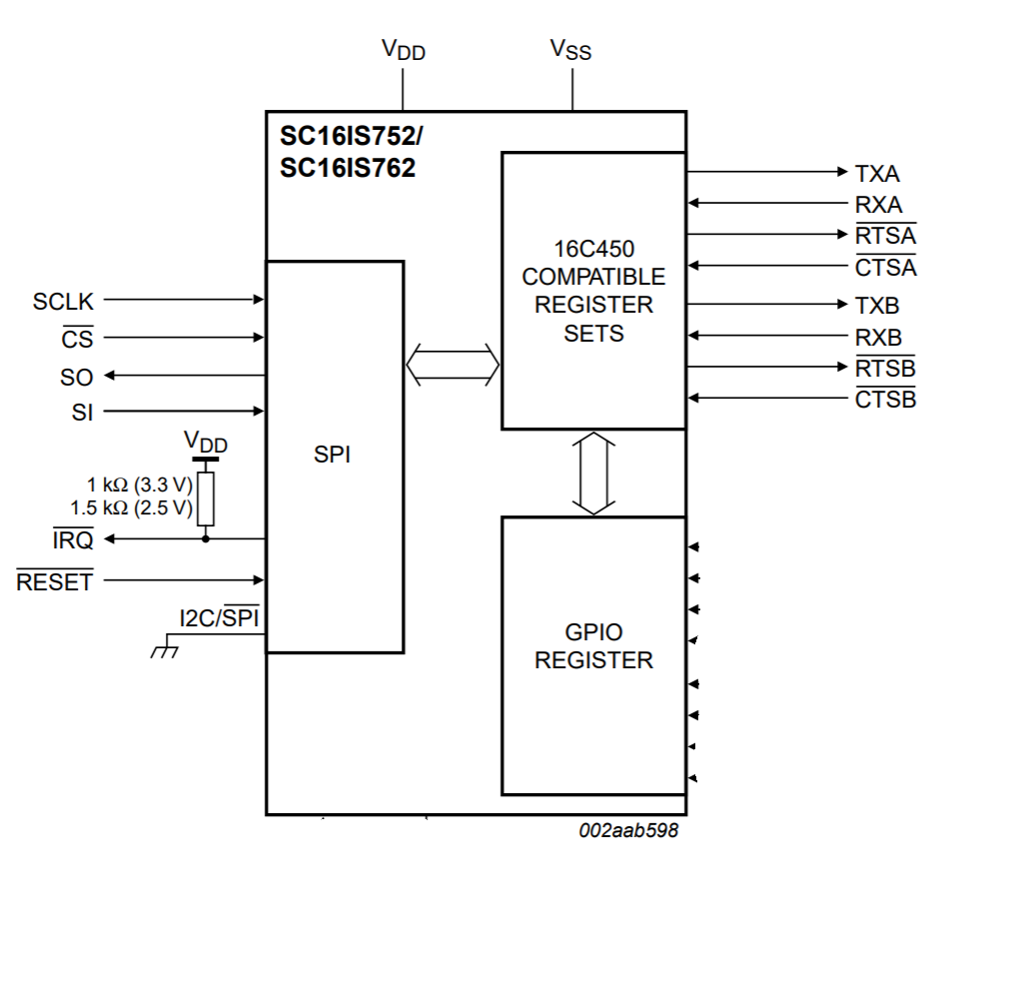
SC16IS752; SC16IS762 Dual UART with I2C-bus/SPI interface
This chip enables seamless protocol conversion from I2C-bus/SPI to RS-232/RS-485 and is fully bidirectional.
SC16IS752 supports 4 Mbit/s maximum SPI clock speed  SC16IS762 supports 15 Mbit/s maximum SPI clock speed
3.3 V or 2.5 V operation
CTSA: UART clear to send (active LOW), channel A. A logic 0 (LOW) on the CTSA pin indicates the modem or data set is ready to accept transmit data from the SC16IS752/SC16IS762
RTSA: UART request to send (active LOW), channel A. A logic 0 on the RTSA pin indicates the transmitter has data ready and waiting to send

Slide 30
PWM: Pulse Width Modulation
A series of pulses generate a rectangular waveform which looks something like the following
Each pulse is characterized by two parameters: period (T) and duty cycle (D)
T may be any length of time
D may be any value in the range 0 ≤ D ≤ 1
The pulse width is D*T
Pulse width modulation allows for the automatic generation of a pulse train with specified period and duty cycle/pulse width
D*T
T

Slide 31
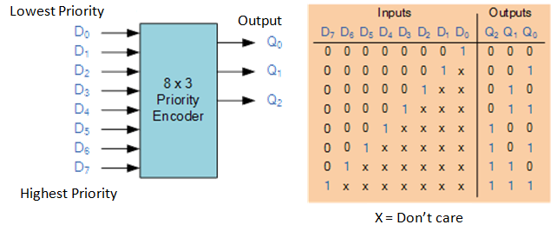
Encoder Logic

Slide 32
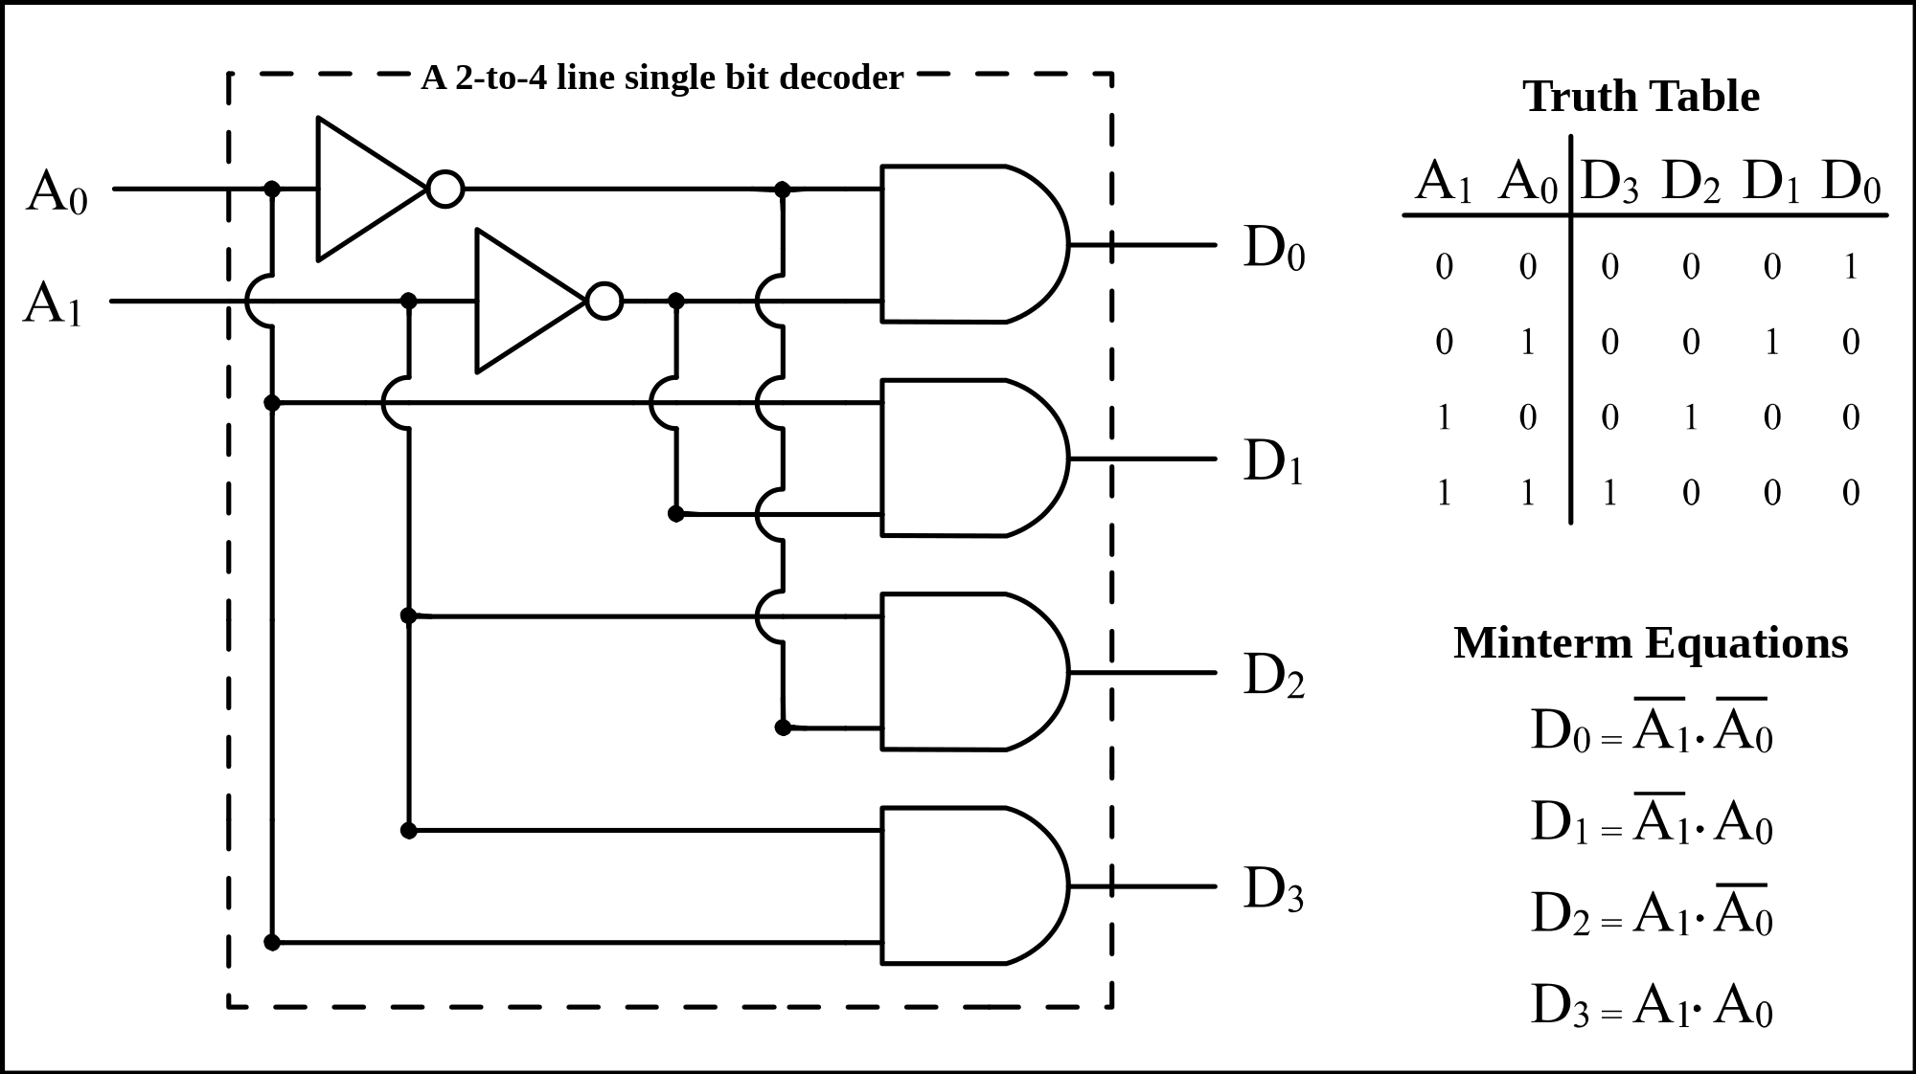
Decoder Logic

Slide 33
TESTING SLIDE
The software testing will first involve testing the functionality of each click independently. This may be accomplished on a breadboard while the hardware interface is under design.
Once the software interface to a click has been completed, the hardware testing will involve testing each click in each socket to be certain that the hardware interface works correctly.
Full system testing will involve the interaction of multiple combinations of various clicks accessed simultaneously through various sockets.

